Slide 1

operationalize AI and make industries more efficient

Slide 2
Introduction to Copula

Slide 3
목차
1. Copula: What & When
2. Sklar Theorem
3. Gaussian Copula
4. GMC: Gaussian Mixture Copula

Slide 4
1. Copula: What & When
Origin of the word “copula” is the latin word “copulare”, which means
- to join together
- link
- tie
https://en.wikipedia.org/wiki/Copula_(probability_theory)

Slide 5
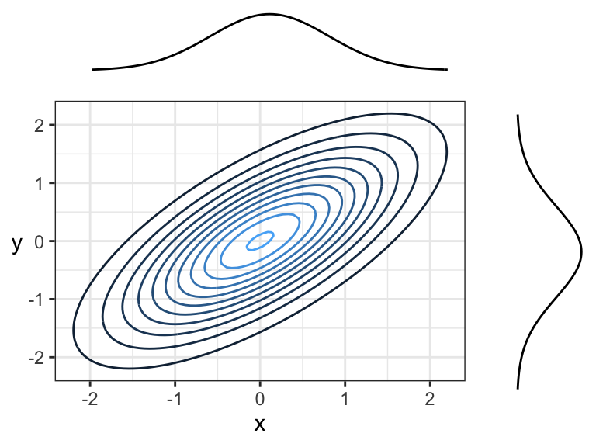
1. Copula: What & When
Marginal Distribution 이 특정 분포(예: Normal Dist.)를 따르지 않는 경우에도, 변수간의 관계를 모델링하고 싶을 때
[ Copula 필요 없음 ]
[ Copula 필요함 ]

Slide 6
1. Copula: What & When
Marginal Distribution 이 특정 분포(예: Normal Dist.)를 따르지 않는 경우에도, 변수간의 관계를 모델링하고 싶을 때
→ Non gaussian pattern 에 대해 적용 가능

Slide 7

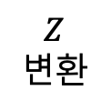
요약
Gaussian Copula: Non Gaussian Pattern 에 대한 분포를 추정하는 한가지 방법
분포 추정이 어려움
(Non Gaussian Pattern)
분포 추정이 쉬움
(Gaussian Pattern)
$$Z$$
변환
생성
(쉬움)
$$생성$$
(쉬움)
$$f\left(x_{1}, …,x_{d}\right)=c\left(F_{1}\left(x_{1}\right), …,F_{d}\left(x_{d}\right)\right) × (f_{1}\left(x_{1}\right)∙f_{2}\left(x_{2}\right)∙∙∙f_{d}\left(x_{d}\right))$$
copula density function
product of marginal distribution

Slide 8
요약
Gaussian Copula: Non Gaussian Pattern 에 대한 분포를 추정하는 한가지 방법
분포 추정이 어려움
(Non Gaussian Pattern)
분포 추정이 쉬움
(Gaussian Pattern)
$$Z$$
변환
생성
(쉬움)
$$생성$$
(쉬움)
$$f\left(x_{1}, …,x_{d}\right)=c\left(F_{1}\left(x_{1}\right), …,F_{d}\left(x_{d}\right)\right) × (f_{1}\left(x_{1}\right)∙f_{2}\left(x_{2}\right)∙∙∙f_{d}\left(x_{d}\right))$$
copula density function
product of marginal distribution

Slide 9
요약
Gaussian Copula: Non Gaussian Pattern 에 대한 분포를 추정하는 한가지 방법
분포 추정이 어려움
(Non Gaussian Pattern)
분포 추정이 쉬움
(Gaussian Pattern)
$$Z$$
변환
생성
(쉬움)
$$생성$$
(쉬움)
$$f\left(x_{1}, …,x_{d}\right)=c\left(F_{1}\left(x_{1}\right), …,F_{d}\left(x_{d}\right)\right) × (f_{1}\left(x_{1}\right)∙f_{2}\left(x_{2}\right)∙∙∙f_{d}\left(x_{d}\right))$$
copula density function
product of marginal distribution

Slide 10
요약
Gaussian Copula: Non Gaussian Pattern 에 대한 분포를 추정하는 한가지 방법
분포 추정이 어려움
(Non Gaussian Pattern)
분포 추정이 쉬움
(Gaussian Pattern)
$$Z$$
변환
생성
(쉬움)
$$생성$$
(쉬움)
$$f\left(x_{1}, …,x_{d}\right)=c\left(F_{1}\left(x_{1}\right), …,F_{d}\left(x_{d}\right)\right) × (f_{1}\left(x_{1}\right)∙f_{2}\left(x_{2}\right)∙∙∙f_{d}\left(x_{d}\right))$$
copula density function
product of marginal distribution

Slide 11
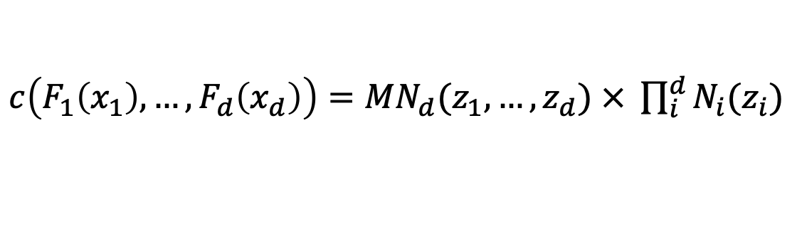

별첨: Gaussian Copula
$c\left(F_{1}\left(x_{1}\right), …,F_{d}\left(x_{d}\right)\right)={MN}_{d}(z_{1}, …,z_{d})$ $× \prod_{i}^{d}{N_{i}(z_{i})}$
$z: x$를 표준 정규분포로 변환한 변수
$$f\left(x_{1}, …,x_{d}\right)=c\left(F_{1}\left(x_{1}\right), …,F_{d}\left(x_{d}\right)\right) × (f_{1}\left(x_{1}\right)∙f_{2}\left(x_{2}\right)∙∙∙f_{d}\left(x_{d}\right))$$
copula density function
product of marginal distribution

Slide 12
별첨: Gaussian Copula
$c\left(F_{1}\left(x_{1}\right), …,F_{d}\left(x_{d}\right)\right)={MN}_{d}(z_{1}, …,z_{d})$ $× \prod_{i}^{d}{N_{i}(z_{i})}$
$z: x$를 표준 정규분포로 변환한 변수
$$f\left(x_{1}, …,x_{d}\right)=c\left(F_{1}\left(x_{1}\right), …,F_{d}\left(x_{d}\right)\right) × (f_{1}\left(x_{1}\right)∙f_{2}\left(x_{2}\right)∙∙∙f_{d}\left(x_{d}\right))$$
copula density function
product of marginal distribution

Slide 13
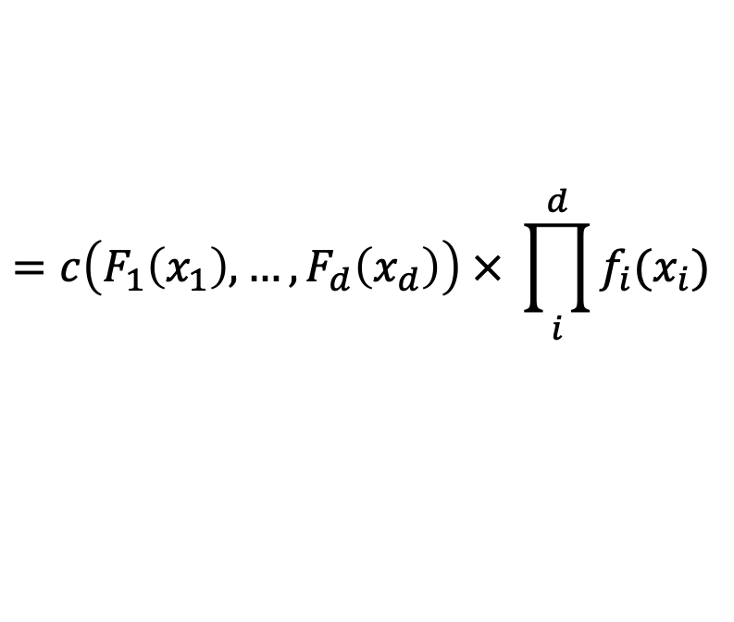
2. Sklar Theorem
Sklar (1959) uses the word ”copula”
& proved “Sklar Theorem”: copula function is unique (if random variables are continuous)
$$f\left(x_{1}, …,x_{d}\right)=c\left(F_{1}\left(x_{1}\right), …,F_{d}\left(x_{d}\right)\right) × (f_{1}\left(x_{1}\right)∙f_{2}\left(x_{2}\right)∙∙∙f_{d}\left(x_{d}\right))$$
$$=c\left(F_{1}\left(x_{1}\right), …,F_{d}\left(x_{d}\right)\right) × \prod_{i}^{d}{f_{i}(x_{i})}$$
copula density function
③ joint distribution 을
구할 수 있음
② copula 함수(값)를
곱하면
① 각 변수의 marginal pdf (곱)에
(copula 함수는 unique)
즉, Copula 함수: 각 변수간의 관계를 설명하는 함수

Slide 14




2. Sklar Theorem
Sklar (1959) uses the word ”copula”
& proved “Sklar Theorem”: copula function is unique (if random variables are continuous)
$$f\left(x_{1}, …,x_{d}\right)=c\left(F_{1}\left(x_{1}\right), …,F_{d}\left(x_{d}\right)\right) × (f_{1}\left(x_{1}\right)∙f_{2}\left(x_{2}\right)∙∙∙f_{d}\left(x_{d}\right))$$
$$=c\left(F_{1}\left(x_{1}\right), …,F_{d}\left(x_{d}\right)\right) × \prod_{i}^{d}{f_{i}(x_{i})}$$
copula density function
$f\left(x_{1}, …,x_{d}\right)\text{: }\text{joint} \text{distribution}$
$c\left(F_{1}\left(x_{1}\right), …,F_{d}\left(x_{d}\right)\right):\text{copula} \text{density} \text{function}$
$x_{i}:random variable$
$F_{i}\left(x_{i}\right):cdf of random variable$
$f_{i}\left(x_{i}\right):pdf of random variable$

Slide 15
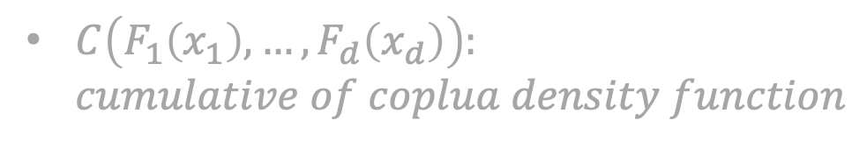

2. Sklar Theorem
Sklar (1959) uses the word ”copula”
& proved “Sklar Theorem”: copula function is unique (if random variables are continuous)
ver 1.
$$f\left(x_{1}, …,x_{d}\right)=c\left(F_{1}\left(x_{1}\right), …,F_{d}\left(x_{d}\right)\right) × (f_{1}\left(x_{1}\right)∙f_{2}\left(x_{2}\right)∙∙∙f_{d}\left(x_{d}\right))$$
$$=c\left(F_{1}\left(x_{1}\right), …,F_{d}\left(x_{d}\right)\right) × \prod_{i}^{d}{f_{i}(x_{i})}$$
copula density function
ver 2.
$$F\left(x_{1}, …,x_{d}\right)=C\left(F_{1}\left(x_{1}\right), …,F_{d}\left(x_{d}\right)\right)$$
$F\left(x_{1}, …,x_{d}\right)\text{: }\text{cumulative} \text{of} \text{joint} \text{pdf}$
$C\left(F_{1}\left(x_{1}\right), …,F_{d}\left(x_{d}\right)\right):$ $cumulative of coplua density function$

Slide 16
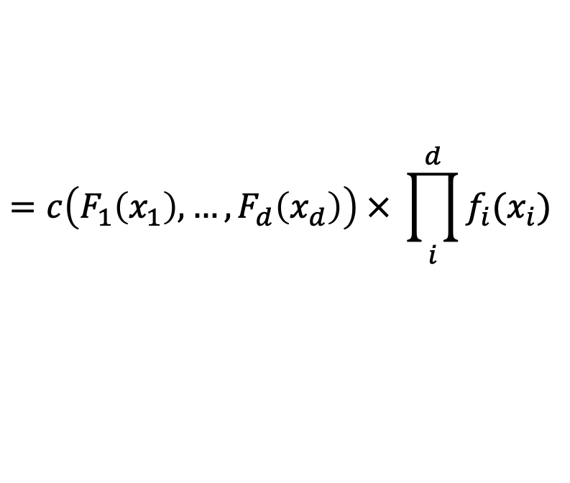


2. Sklar Theorem
ver 1.
$$f\left(x_{1}, …,x_{d}\right)=c\left(F_{1}\left(x_{1}\right), …,F_{d}\left(x_{d}\right)\right) × (f_{1}\left(x_{1}\right)∙f_{2}\left(x_{2}\right)∙∙∙f_{d}\left(x_{d}\right))$$
$$=c\left(F_{1}\left(x_{1}\right), …,F_{d}\left(x_{d}\right)\right) × \prod_{i}^{d}{f_{i}(x_{i})}$$
copula density function
ver 2.
$$F\left(x_{1}, …,x_{d}\right)=C\left(F_{1}\left(x_{1}\right), …,F_{d}\left(x_{d}\right)\right)$$
$F\left(x_{1}, …,x_{d}\right)\text{: }\text{cumulative} \text{of} \text{joint} \text{pdf}$
$C\left(F_{1}\left(x_{1}\right), …,F_{d}\left(x_{d}\right)\right):$ $cumulative of coplua density function$
ver 3.
$$F\left({F_{1}^{−1}(F}_{1}\left(x_{1}\right)), …,{F_{d}^{−1}(F}_{d}\left(x_{d}\right))\right)=C\left(F_{1}\left(x_{1}\right), …,F_{d}\left(x_{d}\right)\right)$$
→ $C\left(F_{1}\left(x_{1}\right), …,F_{d}\left(x_{d}\right)\right)=F\left({F_{1}^{−1}(F}_{1}\left(x_{1}\right)), …,{F_{d}^{−1}(F}_{d}\left(x_{d}\right))\right)$

Slide 17
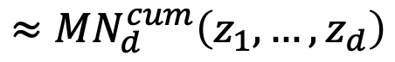
3. Gaussian Copula
If we use gaussian distribution, copula is gaussian copula
( We picked Gaussian but they could be Student-t, Laplace, etc. )
$$C\left(F_{1}\left(x_{1}\right), …,F_{d}\left(x_{d}\right)\right)=F\left({F_{1}^{−1}(F}_{1}\left(x_{1}\right)), …,{F_{d}^{−1}(F}_{d}\left(x_{d}\right))\right)$$
$$≈{MN}_{d}^{cum}\left({F_{1}^{−1}(F}_{1}\left(x_{1}\right)), …,{F_{d}^{−1}(F}_{d}\left(x_{d}\right))\right)$$
$$≈{MN}_{d}^{cum}\left(N_{1}^{−1}\left(F_{1}^{cum}\left(x_{1}\right)\right), …,N_{d}^{−1}\left(F_{d}^{cum}\left(x_{d}\right)\right)\right)$$
$$≈{MN}_{d}^{cum}\left(z_{1}, …,z_{d}\right)$$
Map to standard normal

Slide 18
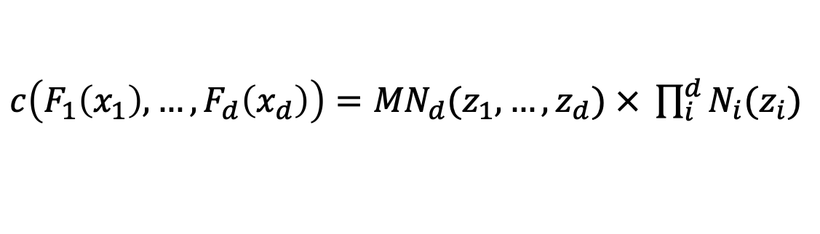
3. Gaussian Copula
$$C\left(F_{1}\left(x_{1}\right), …,F_{d}\left(x_{d}\right)\right)={MN}_{d}^{cum}\left(z_{1}, …,z_{d}\right)$$
→
$c\left(F_{1}\left(x_{1}\right), …,F_{d}\left(x_{d}\right)\right)={MN}_{d}(z_{1}, …,z_{d})$ $× \prod_{i}^{d}{N_{i}(z_{i})}$

Slide 19
3. Gaussian Copula
$c\left(F_{1}\left(x_{1}\right), …,F_{d}\left(x_{d}\right)\right)={MN}_{d}(z_{1}, …,z_{d})$ $× \prod_{i}^{d}{N_{i}(z_{i})}$
$z: x$를 표준 정규분포로 변환한 변수
$$f\left(x_{1}, …,x_{d}\right)=c\left(F_{1}\left(x_{1}\right), …,F_{d}\left(x_{d}\right)\right) × (f_{1}\left(x_{1}\right)∙f_{2}\left(x_{2}\right)∙∙∙f_{d}\left(x_{d}\right))$$
copula density function
product of marginal distribution (Maybe, this terms make non gaussian pattern)

Slide 20
3. Gaussian Copula
$c\left(F_{1}\left(x_{1}\right), …,F_{d}\left(x_{d}\right)\right)={MN}_{d}(z_{1}, …,z_{d})$ $× \prod_{i}^{d}{N_{i}(z_{i})}$
$z: x$를 표준 정규분포로 변환한 변수
$$f\left(x_{1}, …,x_{d}\right)=c\left(F_{1}\left(x_{1}\right), …,F_{d}\left(x_{d}\right)\right) × (f_{1}\left(x_{1}\right)∙f_{2}\left(x_{2}\right)∙∙∙f_{d}\left(x_{d}\right))$$
copula density function
product of marginal distribution
Copulas give the flexibility to capture additional cases where the marginals are not necessarily normal
Using Copulas we can get a closed form expression for the distributions of all these cases
https://stats.stackexchange.com/questions/347955/what-is-the-advantage-of-modelling-dependency-using-copulas

Slide 21
3. Gaussian Copula
Copula is not designed to capture dependencies in multimodal distribution (absence of location parameter)

Slide 22
4. GMC: Gaussian Mixture Copula
GMC is designed to capture dependencies in multimodal distribution
https://pluto.mscc.huji.ac.il/~galelidan/CopulaWorkshop/Material/TewariPoster.pdf

Slide 23
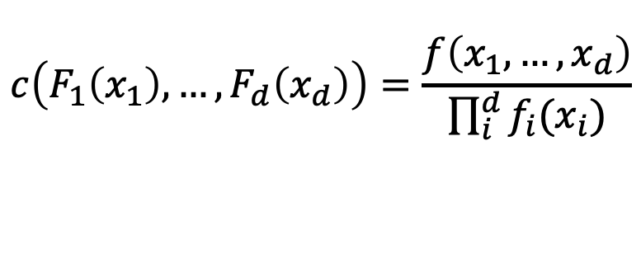
4. GMC: Gaussian Mixture Copula
Recap: Sklar theorem
$$f\left(x_{1}, …,x_{d}\right)=c\left(F_{1}\left(x_{1}\right), …,F_{d}\left(x_{d}\right)\right) × (f_{1}\left(x_{1}\right)∙f_{2}\left(x_{2}\right)∙∙∙f_{d}\left(x_{d}\right))$$
$$=c\left(F_{1}\left(x_{1}\right), …,F_{d}\left(x_{d}\right)\right) × \prod_{i}^{d}{f_{i}(x_{i})}$$
copula density function
product of marginal distribution
$$c\left(F_{1}\left(x_{1}\right), …,F_{d}\left(x_{d}\right)\right)=\frac{f\left(x_{1}, …,x_{d}\right)}{\prod_{i}^{d}{f_{i}(x_{i})}}$$
→

Slide 24
4. GMC: Gaussian Mixture Copula

Slide 25
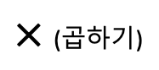
요약
Gaussian Copula: Non Gaussian Pattern 에 대한 분포를 추정하는 한가지 방법
분포 추정이 어려움
(Non Gaussian Pattern)
분포 추정이 쉬움
(Gaussian Pattern)
$$Z$$
변환
생성
(쉬움)
$$생성$$
(쉬움)
$×$ (곱하기)
$$f\left(x_{1}, …,x_{d}\right)=c\left(F_{1}\left(x_{1}\right), …,F_{d}\left(x_{d}\right)\right) × (f_{1}\left(x_{1}\right)∙f_{2}\left(x_{2}\right)∙∙∙f_{d}\left(x_{d}\right))$$
copula density function
product of marginal distribution

Slide 26
Further Reading

Slide 27


